Slide 1
Netzwerk Academy
Machine Learning
By
Navya Raj

Slide 2
How well does the model fit the data points?
Overfitting
Underfitting
Optimal fit

Slide 3
Overfitting:
Model is said to overfit the data points when it tries to fit all the data points including the noise.
Gives very high accuracy on training data
Poor accuracy on test data

Slide 4
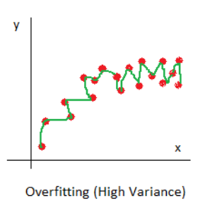
Overfitting
Low Bias
High Variance

Slide 5
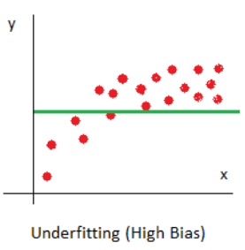
Underfitting:
The model fits very less number of data, resulting in very poor accuracy for training data.
High Bias
Low Variance

Slide 6
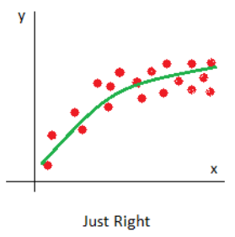
Right fit
Low Bias
Low Variance

Slide 7
Bias:
Bias of a machine learning model is difference between what was expected and what it is predicting.
In other words it is nothing but the training error.
It occurs due to oversimplified assumptions of our model
Variance:
If a machine learning model fits well for training data, but when it is tested on unknown data(or test data), and it performs bad.
In other words it’s basically a error of a test data.
The difference between accuracy on the training data, and the test data accuracy is called variance.

Slide 8
Hyperparameter Tuning:
The whole process of finding the optimal Hyperparameter value is Known as Hyperparameter tuning.
Optimal Hyperparameter
95%
60%
K = 5
K =1
K = 15

Slide 9
Purpose of hyperparameter Tuning:
It is important because hyperparameter directly control the behaviour of the training algorithm.
And a hyperparameter has to be tuned so that Model can optimally solve the ML problems and can improve the accuracy by Minimizing the error

Slide 10
Cross Validation
Cross Validation is a very useful technique for assessing the effectiveness of your model, particularly in cases where you need to mitigate overfitting.
For evaluating the performance of any ML model we need to test it on some unseen data.
To perform CV we need to keep aside a portion of the data which is not used for training the model and later used as a testing data for finding the accuracy.

Slide 11
K-Fold Cross Validation
As there is never enough data to train your model, removing a part of it for validation poses a problem of underfitting.
By reducing the training data, we risk losing important patterns/ trends in data set, which in turn increases error induced by bias.
So, what we require is a method that provides ample data for training the model and also leaves ample data for validation. K Fold cross validation does exactly that.

Slide 12
Performance Metrics in classification
0
1
Accuracy
Confusion Matrix
Precision
Recall
F1 Score
0
TP
FP
1
FN
TN

Slide 13
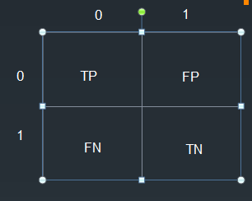
Confusion matrix:
Much better Way to evaluate Classifier
It basically tells that how much time our classifier got confused
TP = True Positive
TN = True Negative
FP = False Positive
FN = False Negative

Slide 14
Type 1 and Type 2 error:
Type 1 error = FP / (FP + TN)
Also known as False positive rate
Type 2 error = FN/ (FN + TP)
Also known as False negative rate

Slide 15
Precision and Recall
Precision: What proportion of actual positive is correctly classified
P = TP/(TP + FP) e.g Spam mail Detection
Recall: What proportion of predicted positive is truly positive
R = TP/(TP + FN) e.g Cancer Detection

Slide 16
F-1 Score:
It is convenient to combine the performance of a classifier i.e precision and recall into a single metric called the F-1 Score.
It is a harmonic Mean of Precision and Recall
F-1 score = 2*Precision*Recall / (Precision + Recall)
F-1 score Is High means Precision and Recall both are high
F-1 score Is low means either precision or recall is low value.

Slide 17
UnderSampling:
Used for handling Imbalance dataset. In this we undersample majority class To match the minority class
Downsampling:
Used for handling imbalance datset. In this we duplicate
The minority classes in order to match the majority calss

